Slide 1
EBSTEINS ANOMALY
DR NIYAS K NASEER
SR CARDIOLOGY

Slide 2
INTRODUCTION
a congenital malformation, in which there is downward (apical) displacement of insertion of septal and posterior leaflets
“Ebstein anomaly,” also referred to as “Ebstein malformation,” was clinically recognized in 1950

Slide 3
HISTORY
Wilhelm Ebstein
The anomaly was first described in 1866 in an autopsy of a 19-year-old labourer who had cyanosis and dyspnea since early childhood
Tourniaire et al
first reported case in a live patient in 1949

Slide 4
PREVALANCE
1 per 20,000 live births
As high as 2.4 per 10,000 live births reported
0.3 to 0.7 percent of all congenital heart defects
Equal male : female incidence
Majority of cases are sporadic
Represents 40% of congenital malformations of TV
Patane et al Int J Cardiol.2009:136:e6-e7.

Slide 5
EMBRYOLOGY
Leaflets and tensile apparatus formed by a process of delamination of the inner layers of the inlet zone of the ventricles
Delamination begins at the tips of the leaflets and proceeds toward the AV junction
In EA - failure of this delamination occurs → Mechanism unknown

Slide 6
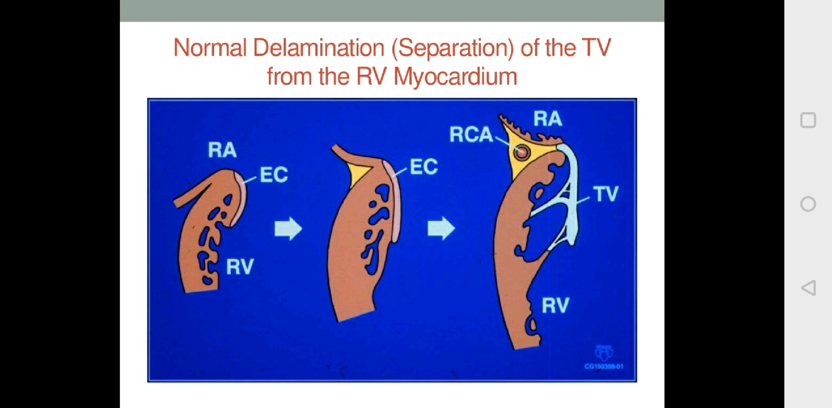
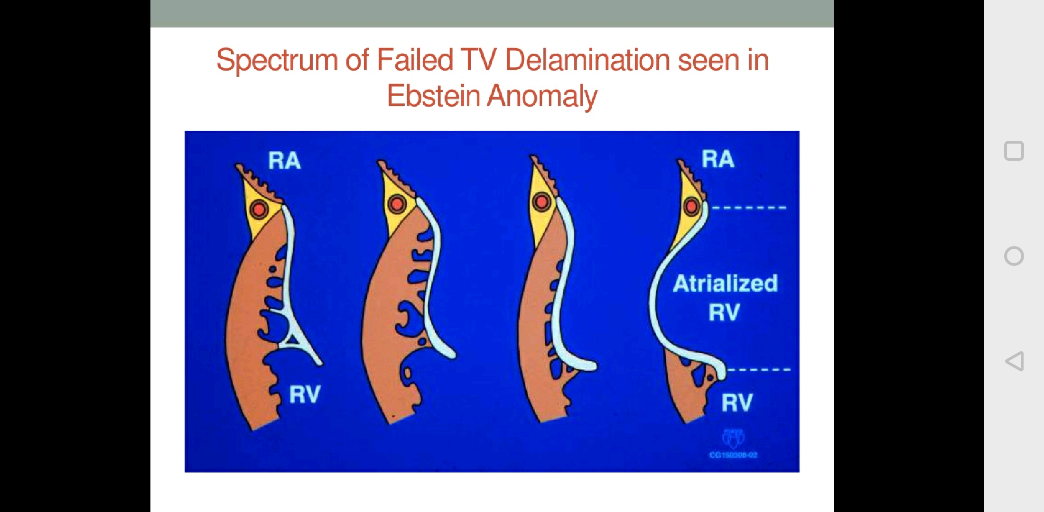
NORMAL
EBSTEINS

Slide 7
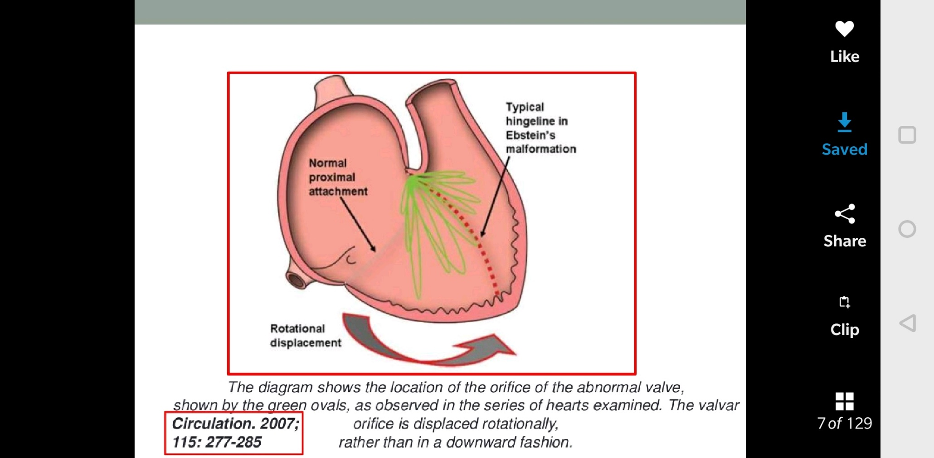
Anterior and apical rotation of functional orifice

Slide 8
ANATOMY- NORMAL TV
Normal TV- basal attachment to annulus(right atrioventricular sulcus) and a peripheral zone into which chordae inserts with a clear zone in between
Anterior leaflet – semicircular –largest
Posterior leaflet- scalloped
Septal leaflet- attached to ventricular septum ,but some part attached to posterior wall
Septal leaflet normally exhibits slight apical displacement at base compared to MV -15mm in children ,20mm in adults

Slide 9
PATHOLOGY
1. Displacement of the septal and posterior leaflets towards apex of the right ventricle (RV)
2. Anterior leaflet is usually attached at the annular level and is large and sail-like with multiple attachments to ventricular wall :fenestrated
3. ‘atrialized RV’ - thin and dysplastic
4. ‘functional RV’ - smaller, lacks inlet portion and has a small trabecular portion
5. Infundibular portion of RV is sometimes obstructed by redundant anterior leaflet or its chordal attachments

Slide 10
Valve Leaflets and Valve Orifice
Septal and posterior leaflets -adherent ,redundant and dysplastic Nodular appearance of the free edge
Anterior leaflet - large and ‘saillike’ – fenestrated- additional tricuspid regurgitation
Rarely, concomitant tricuspid stenosis or even atresia
Redundancy of tricuspid valve tissue may encroach RV outflow tract and cause sub pulmonary stenosis

Slide 12
Right atrium (RA) –
dilated and hypertrophied - depends on
degree of displacement of TV leaflets
resultant tricuspid regurgitation
Right Ventricle -
In mild and moderate cases- normal with mild RV hypertrophy
severe cases-near-normal thickness to very thin and dysplastic

Slide 13
Max point of displacement
Commissure between posterior and septal leaflets
Normal displacement - < 8mm/m2
Gross anatomy depicting
•Dilatation of the atrialized portion of the RV
Electrical potentials of ventricle, but pressure waveform that
of atrium.
•Displaced posterior leaflet
•Septum pushed towards LV and compressing it

Slide 14
Conduction System
AV node is in triangle of Koch , is compressed and closer than usual to coronary sinus ostium
Downward displacement of septal tricuspid leaflet is accompanied by discontinuity between the central fibrous body and the septal atrioventricular ring –create substrate for preexcitation
Accessory pathway ,usually seen around the tricuspid annulus :wolff Parkinson white syndrome -5-25%

Slide 15
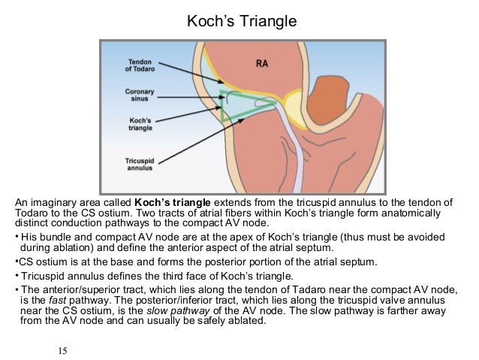

Slide 16
Conduction System
SVT association with Ebstein’s anomaly - related to accessory conduction pathways simulating Wolf-Parkinson-White (WPW) syndrome
Anomalies of the right bundle branch reported -which may explain RBBB pattern seen in ECG
area of triangle of Koch is much smaller in Ebsteins
While AV node and its extensions are normal in size, they are displaced towards the base of Koch triangle and his bundle penetrates well short of the apex of Koch triangle than normal
Practical implication -during treatment of SVT with ablation at the base of Koch triangle may result in higher incidence of AV block

Slide 17
ASSOCIATED CARDIAC ABNORMALITIES

Slide 18
Common associations
Interatrial communication-ASD / PFO-80 – 95% cases
Additional : VSD, RVOT OBST, PDA , Coarctation
Left ventricular abnormalities -39% cases
MVP,systolic dysfunction , subaortic stenosis , BAV, LV muscle bands
Ventricular dysplasia resembling non-compaction seen in 18% cases

Slide 19
Occasional
1.Bicuspid aortic valve
2.Additional mitral valve chordae
3.Accessory mitral valve tissues
4.LV abnormal muscle bands
5.Muscular and perimembranous VSDs
6.Hypoplastic pulmonary arteries

Slide 20
GENETICS AND ENVIRONMENTAL
GENETIC
No single gene defect identified
Sarcomere gene MYH7 mutation –Ebstein anomaly and left ventricular non-compaction
several candidate genes suggested i- GATA4, NKX2.5 and hypothetical genes in 1p36.11
Ebstein anomaly with Williams syndrome
higher incidence for recurrence in the offspring : women (6%) & men (0.6%)
ENVIRONMENTAL
Maternal Lithium ingestion : 500 fold increased risk (Danish registry)
Benzodiazepine use
Exposure to varnishing substances

Slide 21
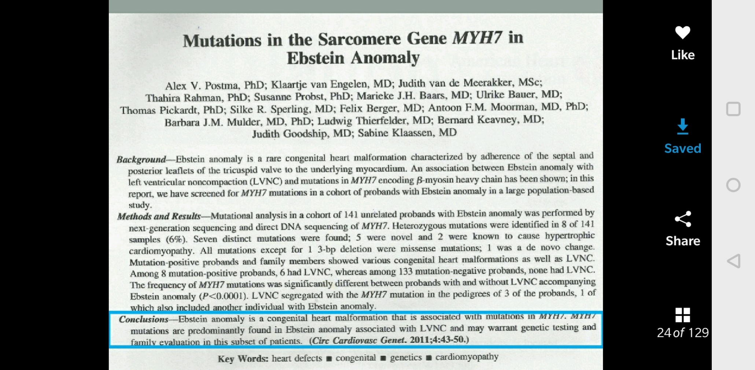

Slide 22
CLASSIFICATION
Echocardiographic assessment – visual
Carpentier classification
Celermajer classification
Classification by anatomical findings at surgery

Slide 23
Echocardiographic assessment
Classified as mild, moderate or severe-
Variables assessed :
Amount of leaflet displacement
Tethering
Degree of RV dilatation

Slide 25
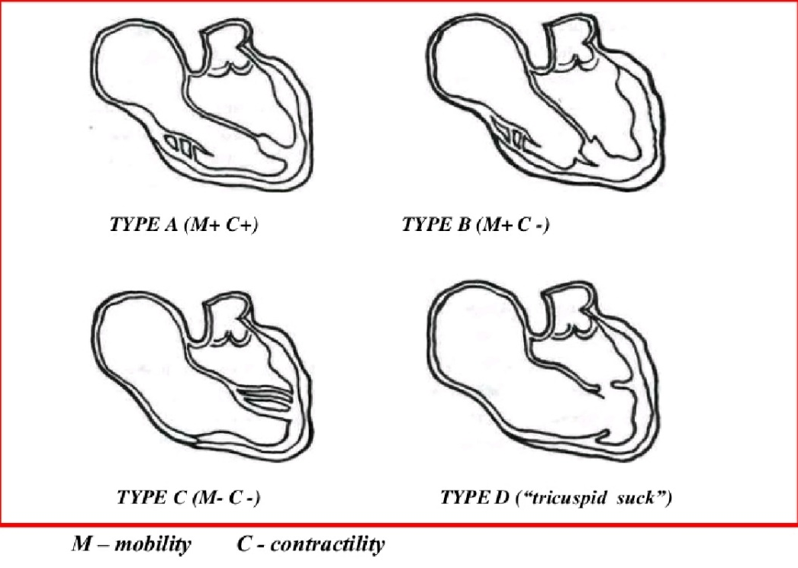
Carpentier classification

Slide 26
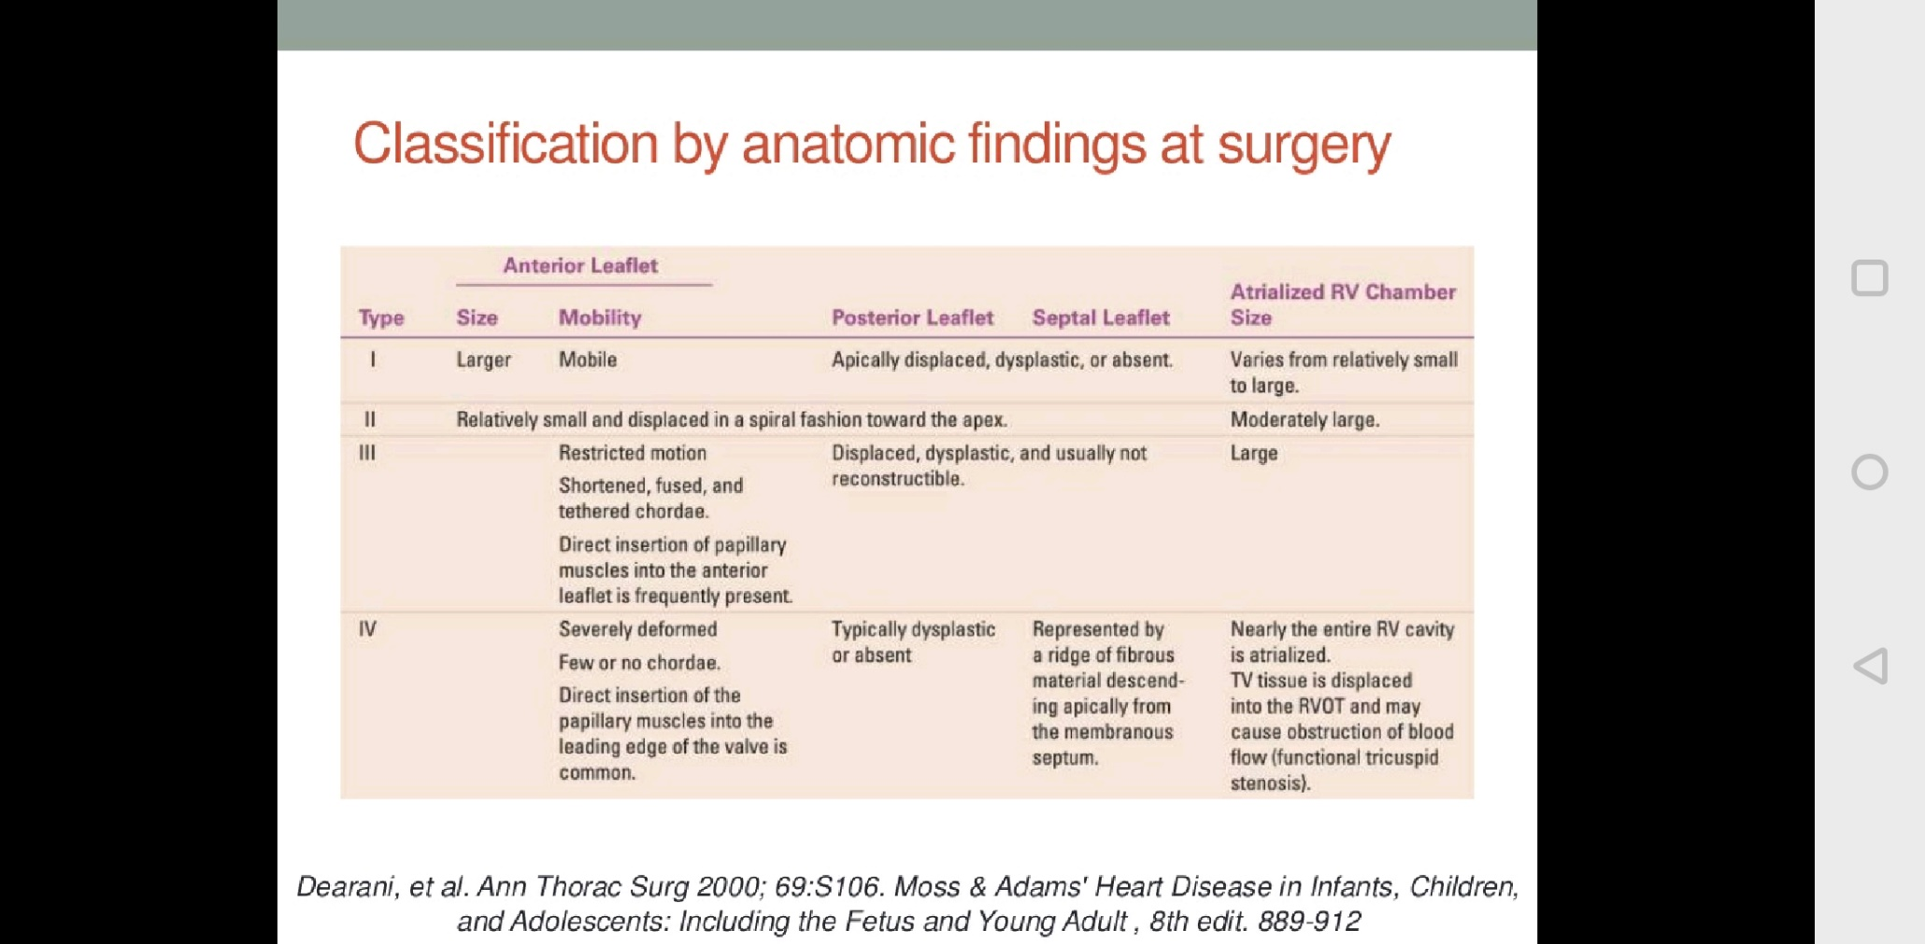

Slide 27
Pathophysiology
main determinants - degree of displacement of TV and degree of TR
mild Ebstein –
tricuspid valve function is close to normal
moderate to severe forms-
with each atrial contraction→ blood is propelled into the atrialized RV
With ventricular contraction that follows- blood is forced back into the right atrium
more pronounced in children with significant TR
With the next atrial contraction, this blood is forced back into the atrialized RV

Slide 28
“ping-pong effect”
causes right atrial dilatation and increases right atrial pressure
right to left shunt across ASD/ PFO
arterial desaturation and pulmonary oligemia.

Slide 29
Newborn babies with severe Ebstein anomaly - cyanotic secondary to R→ L shunt across atrial septum
This is further accentuated by the usual high pulmonary vascular resistance that exists at this age
Significant TR causes severe RA enlargement in utero as well as after birth
inadequate RV myocardium to generate high enough pressure to achieve forward flow via the pulmonary valve
high PVR :inability of the pulmonary valve leaflets to open
‘functional’ pulmonary atresia

Slide 30
PVR DECREASE
pulmonary valve may open
R → L shunting at atrial septal level decrease→ cyanosis decreases
establishment of forward flow via the pulmonary valve
Cyanosis may return in later childhood or adolescence when tricuspid valve function deteriorates (causing regurgitation)
This clinical course is described as ‘transient’ or ‘intermittent’ cyanosis

Slide 31
Clinical Presentation
Wide spectrum of pathophysiology- differing presentations
Fetus :
present as cardiomegaly,tricuspid regurgitation, with RA enlargement on fetal echocardiography, arrhythmia or heart failure with hydrops.
high incidence of fetal loss
Neonates and Infants :
milder forms →asymptomatic
severe forms → symptomatic and have severe cardiomegaly : associated lung hypoplasia
no forward flow due to ineffective RV and inability to overcome the high PVR that exists in the early neonatal period
functional/physiological pulmonary atresia
pulmonary blood flow is dependent on ductal patency

Slide 32
Systemic venous return from RA needs PFO or ASD for egress
R → L shunt : significant cyanosis in newborn
If PFO is restrictive→ right atrial hypertension and systemic venous congestion occur
If ductus arteriosus is inadequate→ poor oxygenation from diminished blood flow and inadequate cardiac output due to poor pulmonary venous return coupled with small shunt via the PFO
leads to severe cyanosis and severe metabolic acidosis in the newborn
Cyanosis - approximately 50 percent newborn
Murmur are less common presenting features. Incidental finding of cardiomegaly in a chest X-ray performed for another purpose is another mode of presentation

Slide 33
Children, Adolescents and Adults
largely asymptomatic -may be detected by cardiac murmur or by echocardiogram performed for an unrelated problem
Infants with moderate to severe forms, who improved -may become symptomatic as the tricuspid valve and right ventricular function deteriorates
Easy fatigability, cyanosis or arrhythmia may be presenting symptoms

Slide 34
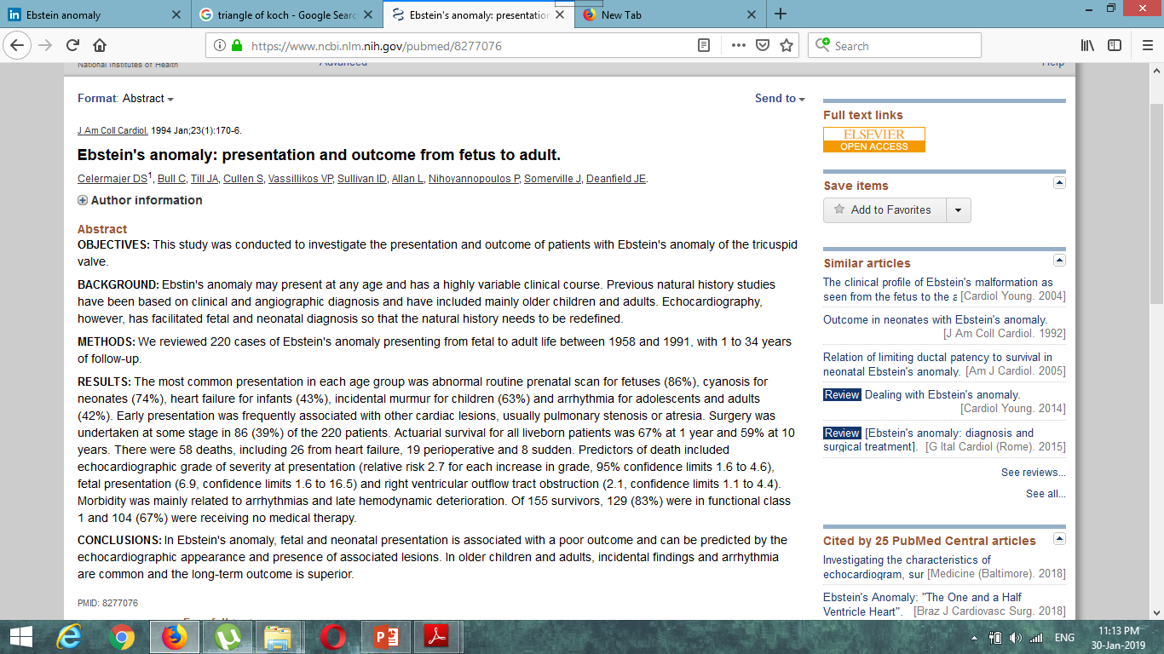

Slide 36
Celermajer et al reviewed 220 cases with Ebstein anomaly-
most common presenting symptom varied with age—
abnormal prenatal scans for foetuses- 86 percent,
cyanosis for neonates - 74 percent
heart failure for infants - 43 percent
incidental murmur for children- 63 percent
arrhythmia for adolescents and adults - 42 percent

Slide 37
Arrhythmia
Supraventricular tachycardia (SVT) is common- secondary to accessory pathways or atrioventricular reentry.
Atrial arrhythmias such as atrial flutter or fibrillation may also be present
Accessory atrioventricular pathways are present in 20 % ; nearly all of them are right-sided pathways
Accessory pathways -located in the inferior portion of the tricuspid valve annulus—most commonly posteroseptal and posterolateral pathways
Due to slow conduction properties of the accessory pathways that are located in the atrialized portion of the RV, the conduction goes through AV node more often and therefore, most of these accessory pathways do manifest in sinus rhythm

Slide 38
In a multicenter study of pediatric patients with Ebstein anomaly in Netherlands,there was 17 %(16 of 93 patients) incidence of arrhythmias .Nine of them developed arrhythmias in the newborn period. One neonate died at 6 days of age from intractable SVT associated with heart failure and cyanosis. Another neonate is suspected to have had arrhythmic death at 4 weeks of age. All 14 survivors exhibited pre-excitation in the electrocardiogram (EKG)
incidence of arrhythmia in pediatric patients with Ebstein anomaly is much lower than that in adults
Notes:
. In adults, additional atrial arrhythmias due to long-standing tricuspid regurgitation and right atrial dilatation adds atrial flutter or fibrillation to the complement of arrhythmias.

Slide 39
SYMPTOMS
Around 35% patients present in infancy and 65% present in older age groups (adolescence and adulthood)
Of those patients presenting in infancy, majority present with heart failure

Slide 40
Fetal life
Incidental diagnosis on routine antenatal echo
Hydrops fetalis is an ominous sign
Cardiomegaly and tachyarrhythmias – also detectable
Neonatal life
Severe cyanosis or heart failure
Cyanosis improves with decreasing pulmonary vascular resistance

Slide 41
Adult life
Fatigue
Exertional dyspnea
Cyanosis
Worsening TR
Right heart failure
Left heart failure
Palpitations/ arrhythmias
Paradoxical embolism
Incidental murmur

Slide 42
Physical examination
Cyanosis and clubbing
Hyperdynamic precordium with Precordial asymmetry
Usually left parasternal prominence and occasionally right parasternal prominence Absence of left parasternal heave importantly rules out the diagnosis
Arterial pulses Normal to diminished in volume
Thrill in LLSB

Slide 43
JVP
Usually normal except for a prominent C wave that coincides with the mobility of anterior tricuspid leaflet
An attenuated X descent and a systolic V wave of TR rarely appear despite regurgitant flow because of:
1. damping effect of commodious right atrium
2. thin walled toneless atrialized right ventricle
3.tricuspid regurgitation is low pressure and hypokinetic

Slide 44
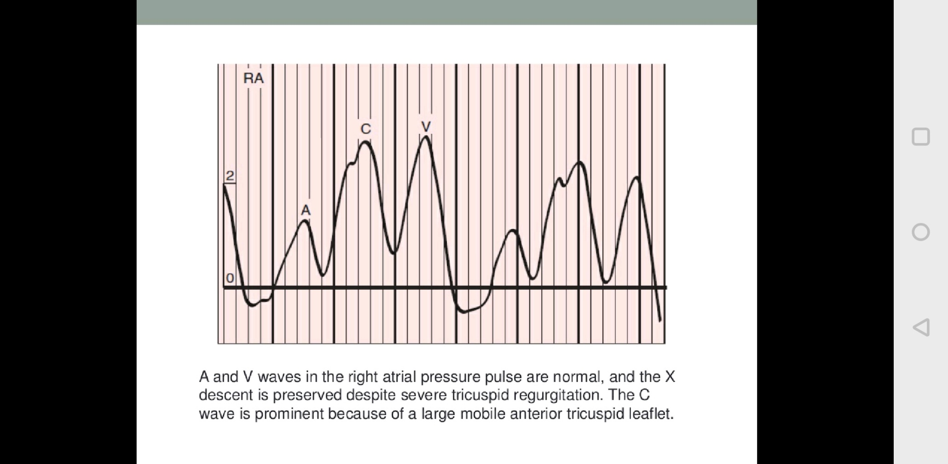

Slide 45
Heart sounds
  S1 Widely split with tricuspid component loud( the SAIL SOUND)
  Mitral component soft – (long PR interval)
  S2 Usually is normal
  In presence of RBBB – may produce a wide variable split
  S3 and S4 Usually heard (triple or quadruple rhythm)
  Origin of S3 is debated – probably due to the fluttering of the tricuspid leaflet during diastole
TR murmur –early systolic decrescendo murmur(low pressure TR)
MDM

Slide 46
Notes:
Phonocardiograms and carotid pulse (CAR) from an acyanotic 22-year-old woman with Ebstein’s anomaly. The first heart sound is widely split. The tricuspid component (T)
is prominent in the third left intercostal space (3 LICS) rather than at the apex. There is a soft decrescendo tricuspid systolic
murmur (SM). A third heart sound (S3) and a fourth sound with duration (S4) were recorded in the first cycle. In the second cycle, the third and fourth heart sounds fuse to form a short mid-diastolic murmur (DM). (M ¼ mitral component.)

Slide 47
CHEST XRAY
Severe cardiomegaly (box like contour)
right atrial silhouette almost always enlargement
Lung fields are either normal or oligemic
Infundibulum either straightens left cardiac border or forms a conspicuous convex shoulder
Cardiomegaly in milder cases is commensurate with the severity of tricuspid regurgitation.

Slide 48
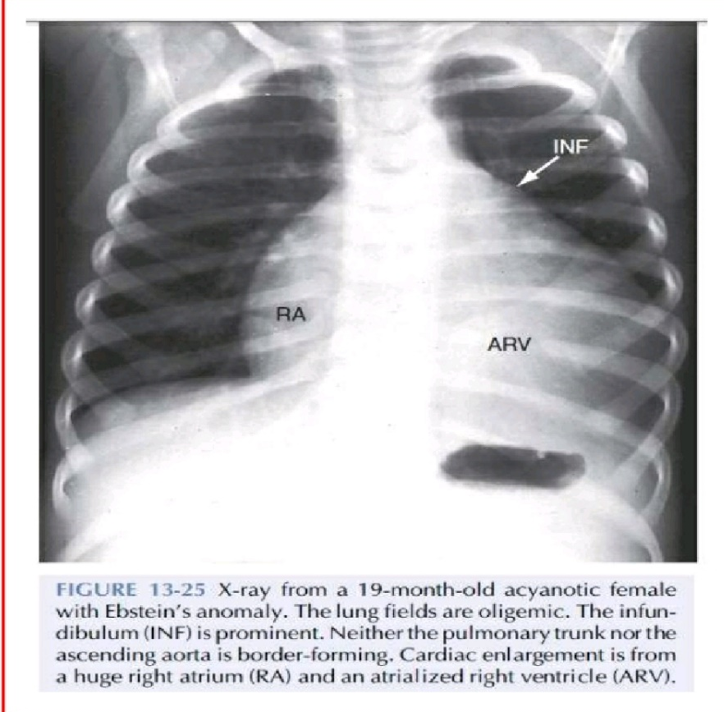
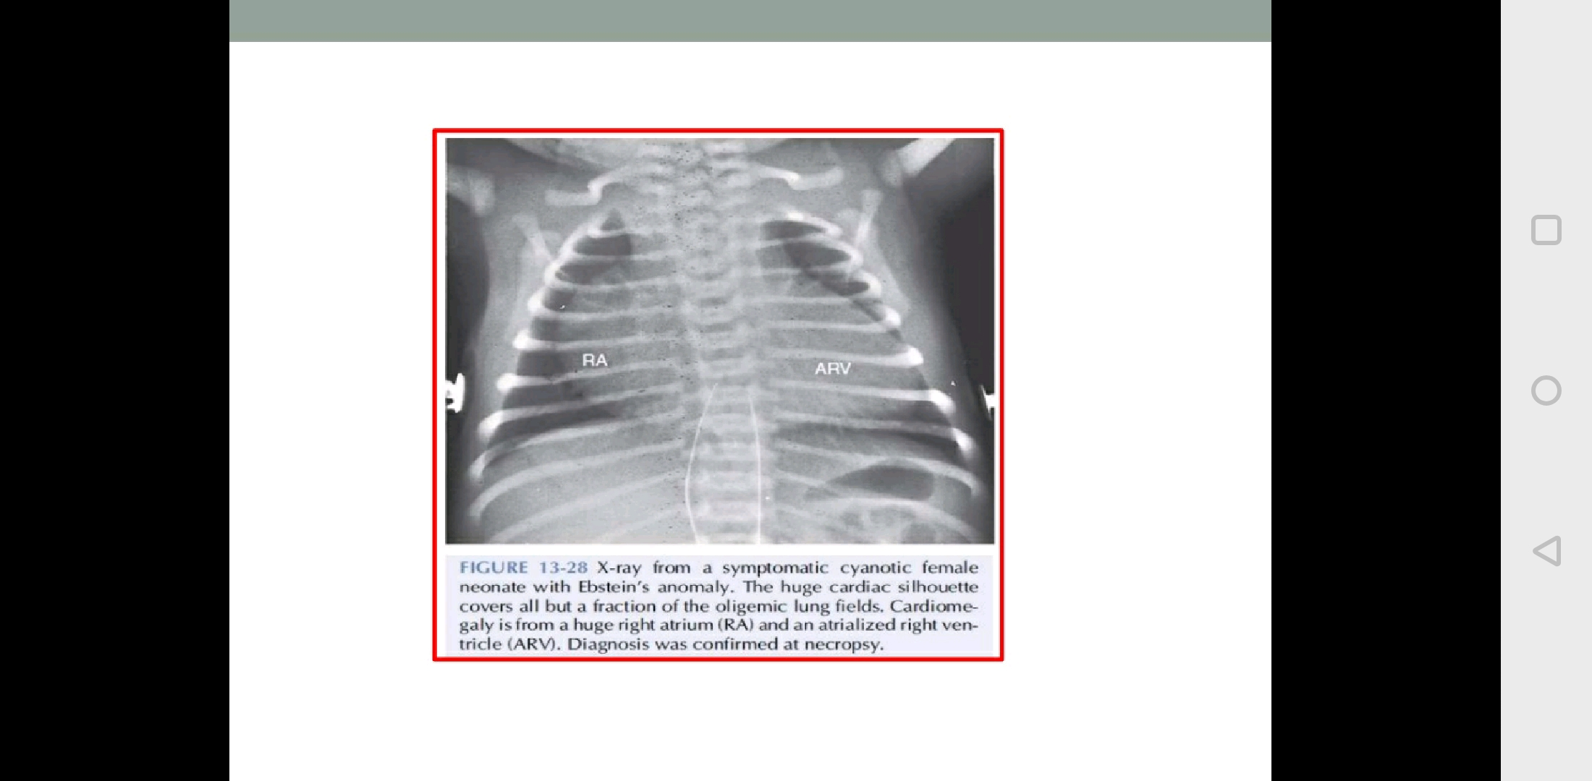

Slide 49
ELECTROCARDIOGRAPHY
Right atrial enlargement
low QRS voltages and right bundle branch block (RBBB) - typical findings in Ebstein anomaly
Right axis deviation is usual
Rarely, left axis deviation may be noted
Prolongation of PR interval -2/3RD
Features of WPW syndrome with short PR interval are reported with higher frequency (30%) in Ebstein anomaly while a few (12%) have evidence of pre-excitation with normal PR interval

Slide 51
Notes:
The typical electrocardiogram includes PR interval prolongation, tall peaked right atrial P waves in lead 2 and V2-5, complete right bundle branch block, and QR
complexes in leads V1-4.
1

Slide 52
Notes:
17-year-old boy with Ebstein’s anomaly. Low-amplitude P waves are peaked in leads V1-2 but are otherwise normal. A short PR interval is followed by
delta waves that are positive in leads 1, aVL, and V4-6 and are negative in leads 2, 3, and aVF. These patterns suggest a right posterior septal accessory pathway. The delta wave is isoelectric in leads V1 and V2, which is presumptive evidence that the accessory pathway is in the right posterolateral free wall.

Slide 53
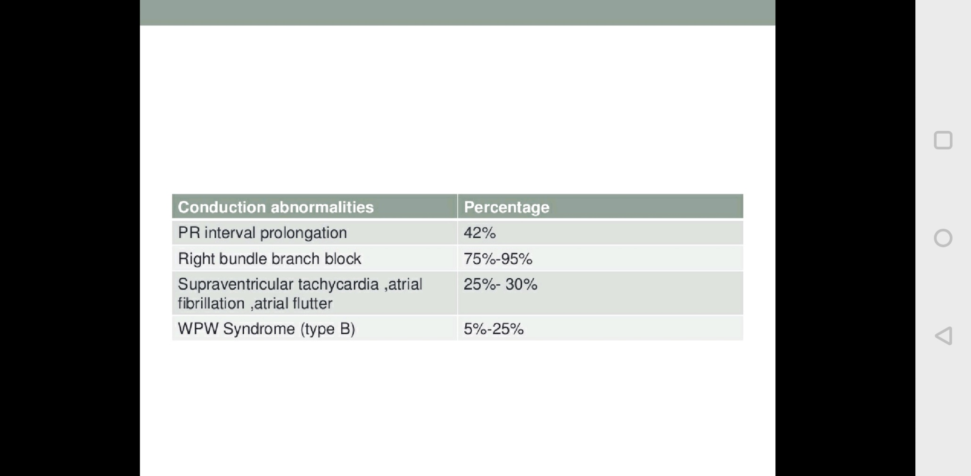

Slide 54
ECHOCARDIOGRAPHY
“Displacement Index” is measured in systole or diastole from the insertion point of the anterior mitral leaflet to the hinge point of the tricuspid septal leaflet
displacement index >8 mm/m2 -diagnosis of Ebstein anomaly
determination of forward flow through RVOT and across the pulmonary valve
difficult in the neonatal setting with elevated pulmonary vascular resistance
pulmonary regurgitation -differentiate anatomic atresia from the more common “functional” atresia of the pulmonary valve

Slide 55
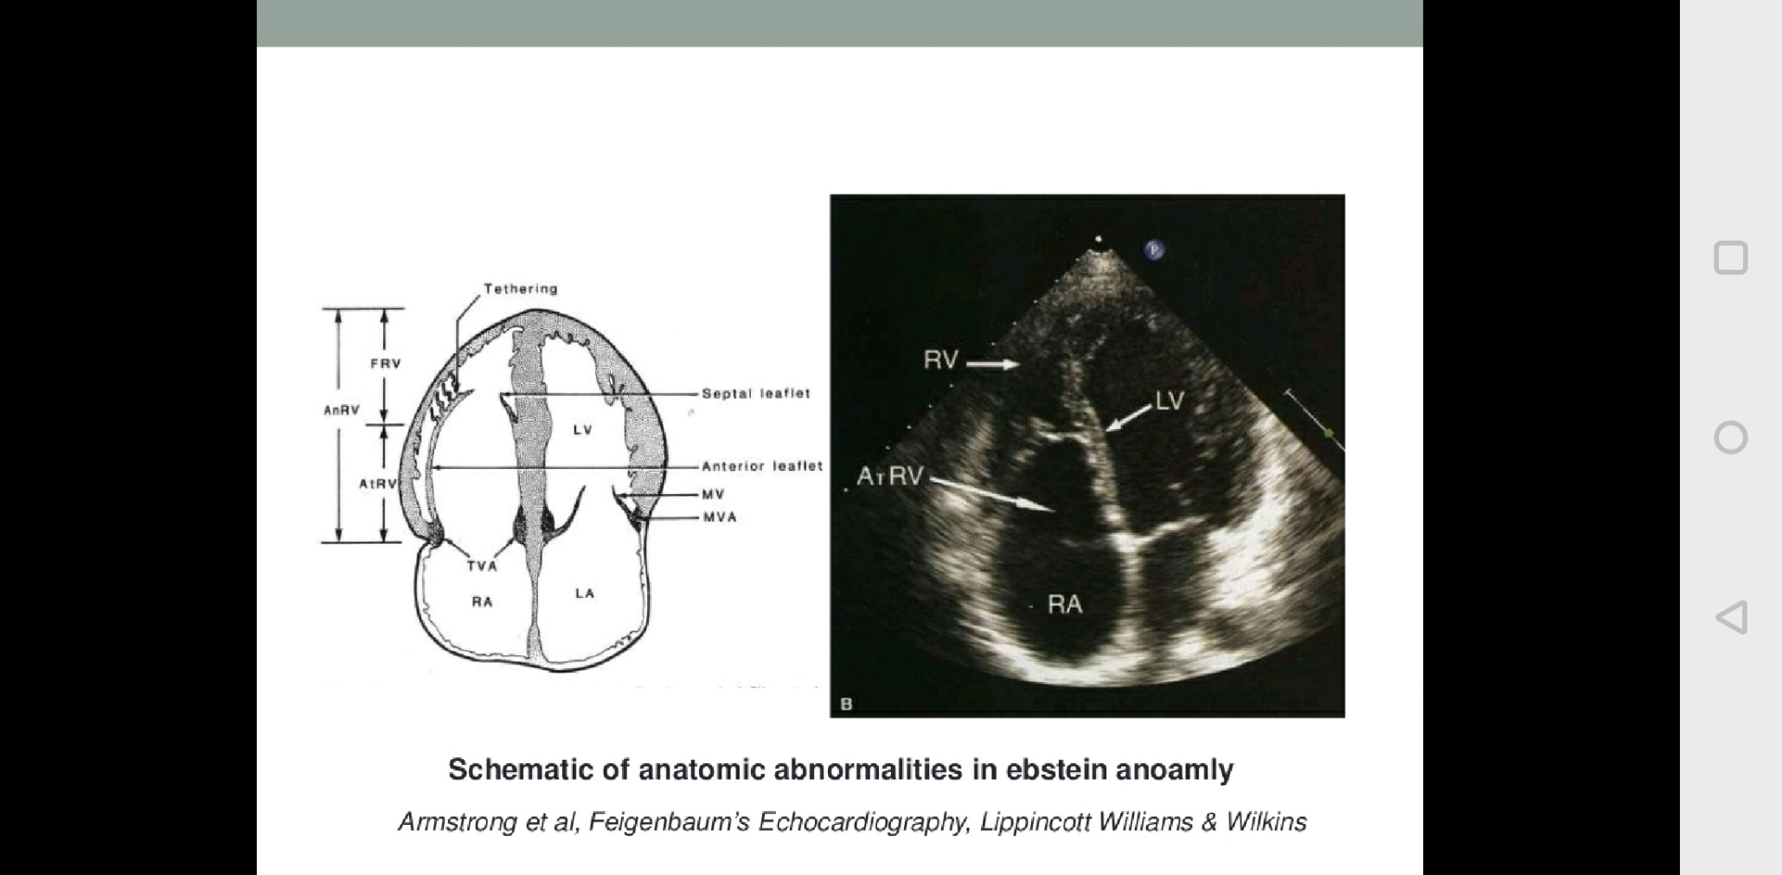

Slide 56
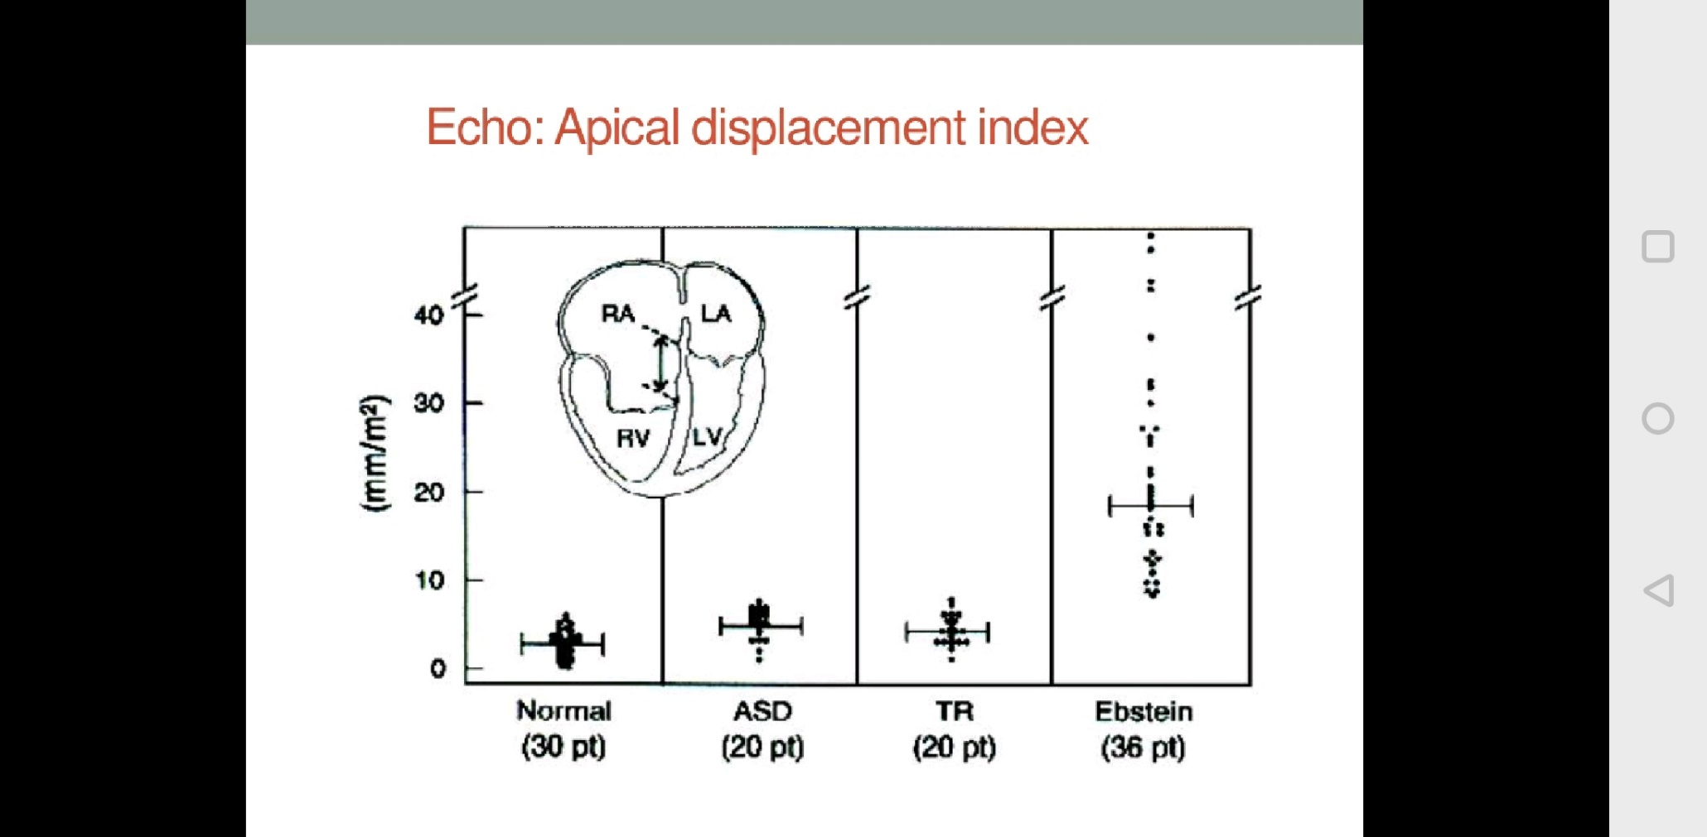

Slide 57
M mode
Paradoxical septal motion
Dilated right ventricle
Delayed closure of tricuspid valve leaflets more than 65 milliseconds after mitral valve closure
2D echo
Eccentric coaptation
Dilated RA
Dilated RV with decreased contractile performance
Eccentric leaflet coaptation

Slide 58
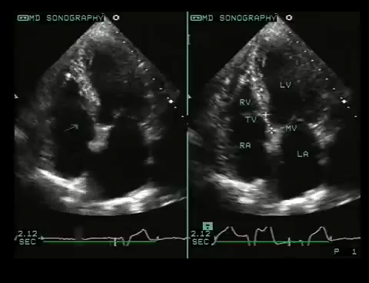

Slide 59
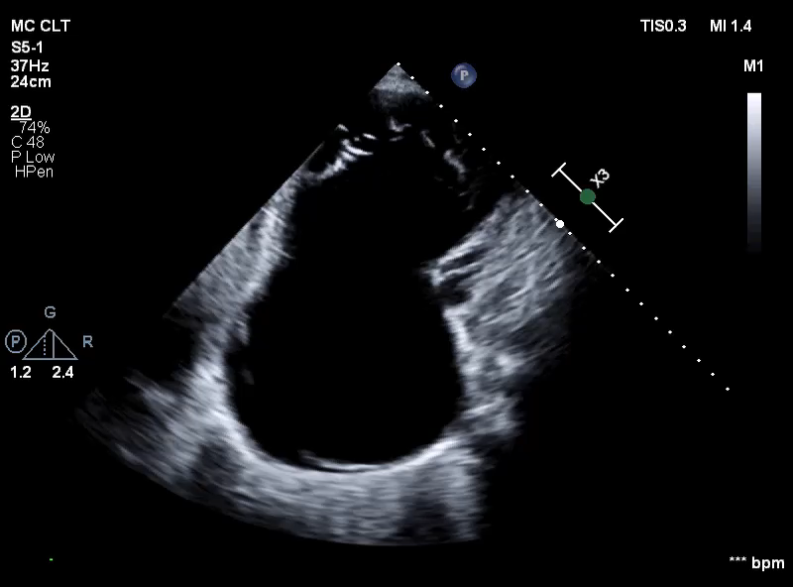
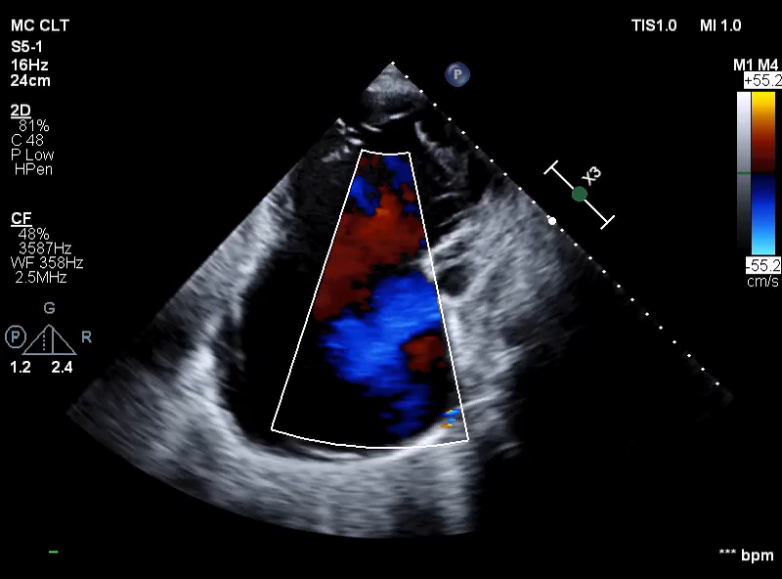

Slide 60
FETAL ECHO
Prenatal diagnosis can be made at 16 to 20 wks of gestation
Most fetus tolerate ebstein anomaly well as the LV function is normal in most cases but in rare cases , progress to fetal hydrops
Cardiac enlargement can compromise pulmonary development
Assessment of RV outflow tract is extremely important –functional PA –fetus require PGE1

Slide 61
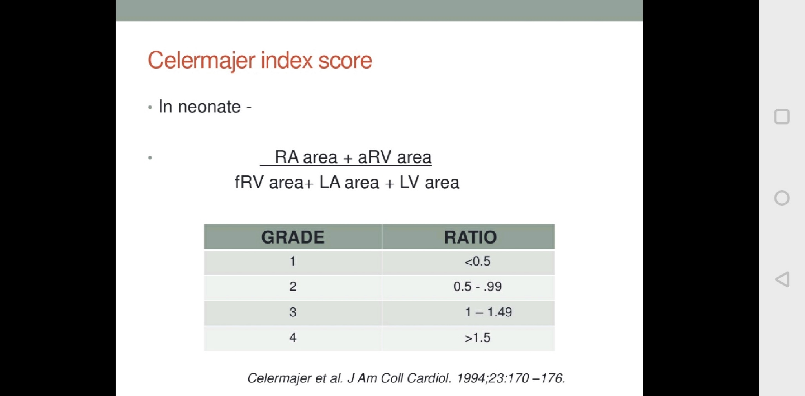

Slide 62
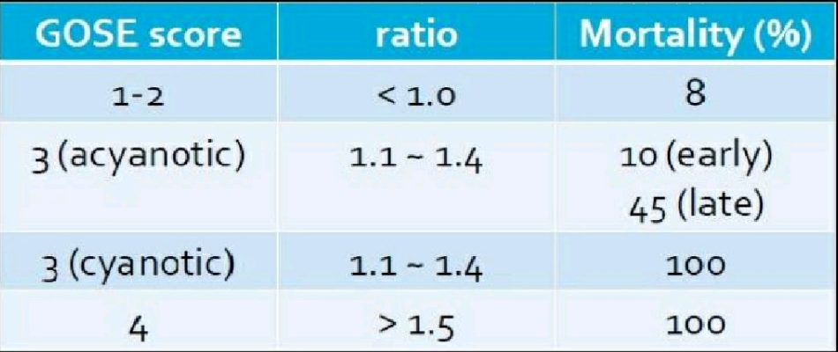
Great Ormond Street Echocardiography (GOSE) score

Slide 63
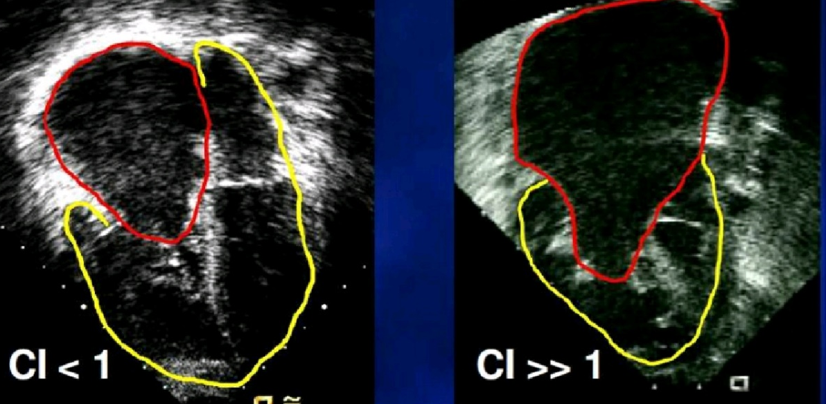

Slide 64
FETAL ECHO
Notes:
Scores of 0 to 10 are possible. There were no survivors when the score was greater than or equal to 5. Conversely, when the scores were less than or equal to 3, survival was 91 percent.

Slide 65
FETAL ECHO
following are associated with death by 3 months of age—
severe RV outflow tract obstruction
tethered distal attachment of anterior leaflet
RV dysplasia
LV compression by RV dilatation
Celermajer index exceeding one

Slide 66
CT AND MRI
MRI – quantitative measurement of right atrial and RV size and systolic function
3D imaging for better delineation of disease severity

Slide 67
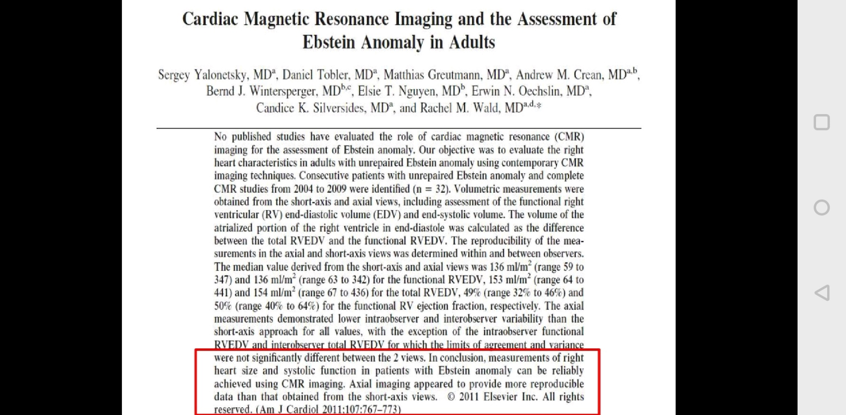

Slide 68
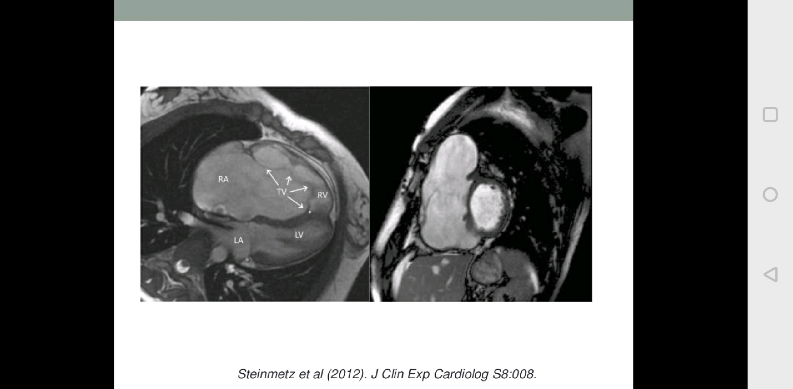
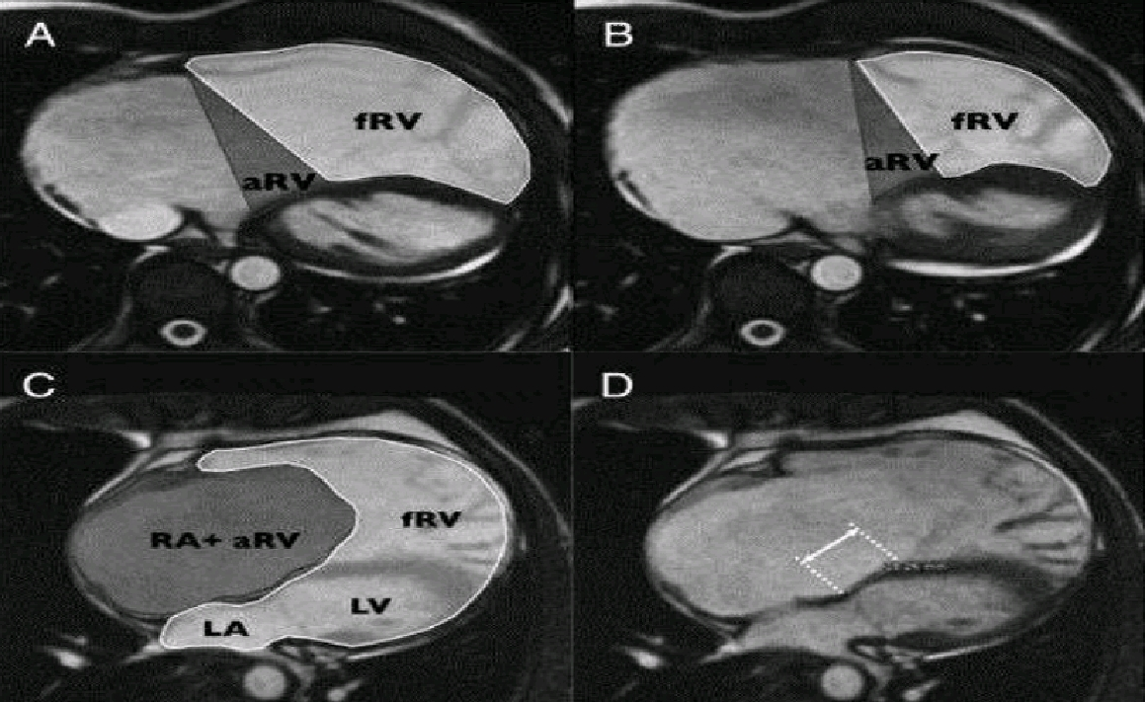

Slide 69
Cardiac Catheterization
not usually necessary :indicated for therapeutic purposes-associated, significant pulmonary stenosis
Catheterization :R → L shunting at atrial by oximetry. Left to right shunting is unusual unless there is VSD or PDA
Pressure traces —
RA pressure (mean) elevated; ‘a’ waves are more prominent than ‘v’ waves because of dissipation of tricuspid regurgitation in a large, compliant right atrium
Right ventricular pressure is low or normal
Low RV systolic pressure is a poor prognostic sign-indicative of inability of the RV to mount enough pressure to enable adequate forward flow via pulmonary valve
High RV systolic pressure is noted in the presence of VSD, PS or high PVR
RV enddiastolic pressure is usually elevated
Left sided pressures (left atrium, left ventricle and aorta) are normal
Tricuspid insufficiency during selective right ventricular angiography and right atrial angiography (not necessary) produces a trilobed heart representing, RA, atrialized portion of RV and RV

Slide 71
NATURAL HISTORY
extremely variable
The clinical course depends on issues related to the tricuspid valve apparatus, RV function and RV size and presence of an ASD
Intrauterine death or profound congestive heart failure in the neonatal period - one end of the spectrum
asymptomatic adults with only a mild degree of valve displacement and RV dysfunction –other end

Slide 72
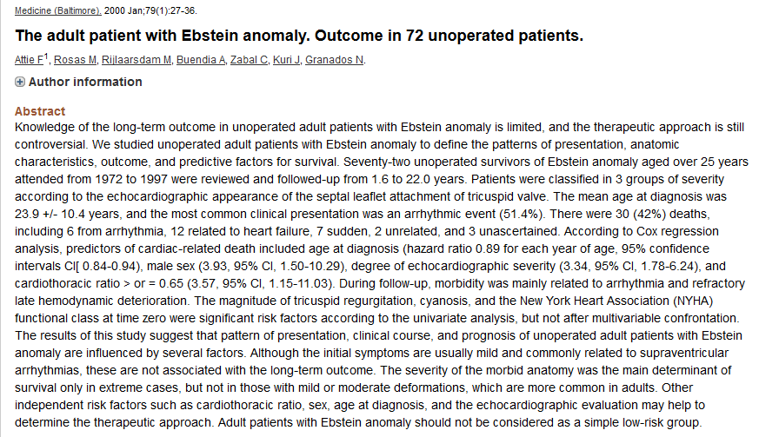

Slide 73
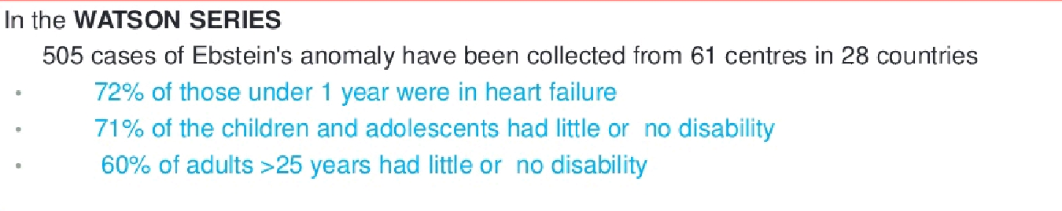

Slide 75
MORTALITY
NEONATAL DEATH- severe hypoxemia , congestive heart failure or both
Younger patients- congestive heart failure
Older patients(20%) –with hemodynamically mild lesions –from atrial or ventricular arrhythmias
Brain abscess or paradoxical embolism and infective endocarditis-rare
Mortality in neonatal period is 20%-40% and less than 50% survive to 5 yrs
Mortality at all ages is 12.5%

Slide 76
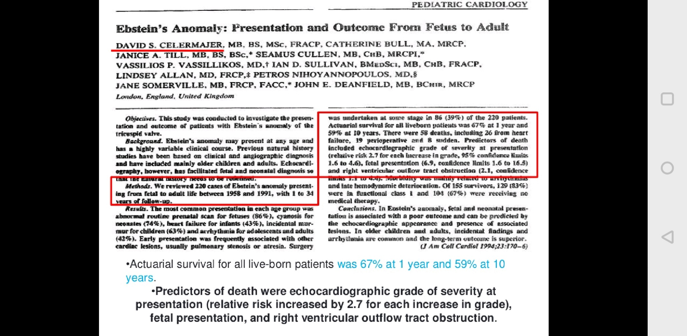

Slide 77
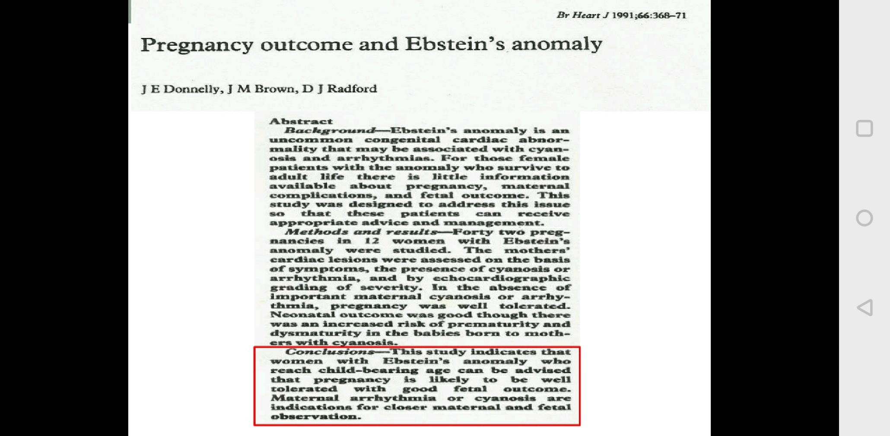
PREGNANCY
Increased incidence of prematurity and probably of spontaneous abortion
CHD incidence in offsprings- 6%

Slide 81
Management
Medical Management
Surgical Management

Slide 82
NEONATAL EBSTEIN
Poor prognosis
Reported survival only 68%
Indication for surgery
Heart failure
Profound cyanosis

Slide 83
NEWBORN
Asymptomatic cyanotic - no active treatment
cyanosis severe PG E1 infusion (0.05–0.1 mcg/kg/min) until PVR drops.(temporarily keeping the PDA open )
inhaled nitric oxide to reduce PVR
Intubation ,positive pressure ventilation ,Deep sedation and muscle relaxant
surgical systemic-pulmonary shunt to maintain adequate pulmonary blood flow
Furosemide and Digoxin- heart failure
Supraventricular tachycardia or atrial flutter -anti-arrhythmic medications
Restrictive PFO/ASD may require balloon atrial septostomy

Slide 85
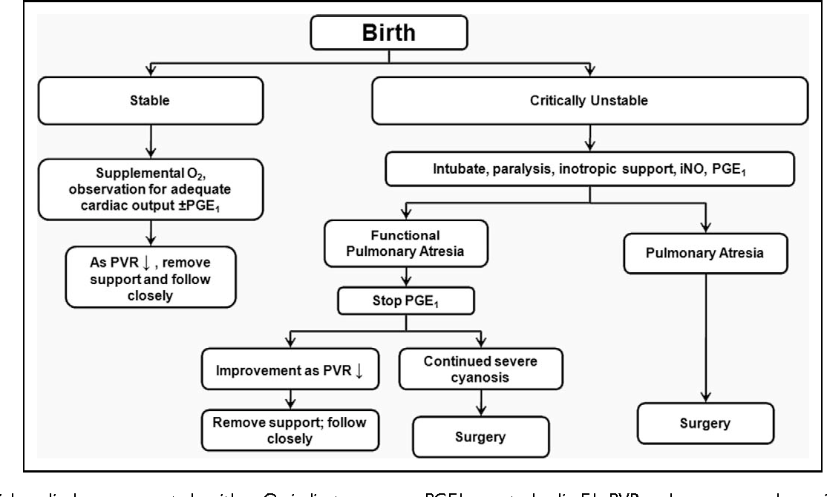

Slide 86
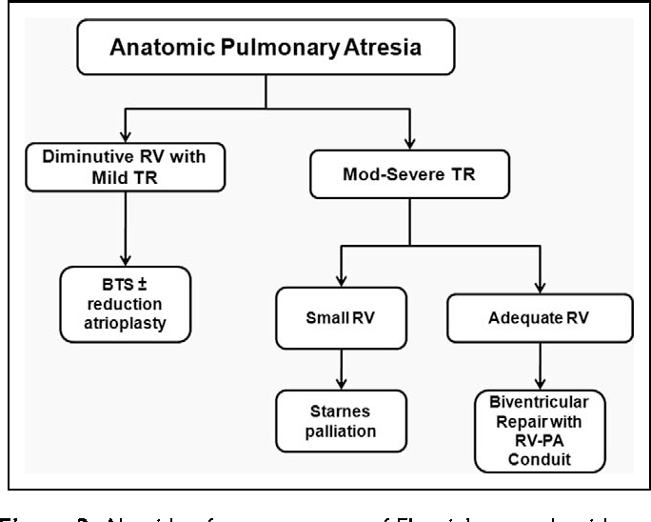

Slide 87
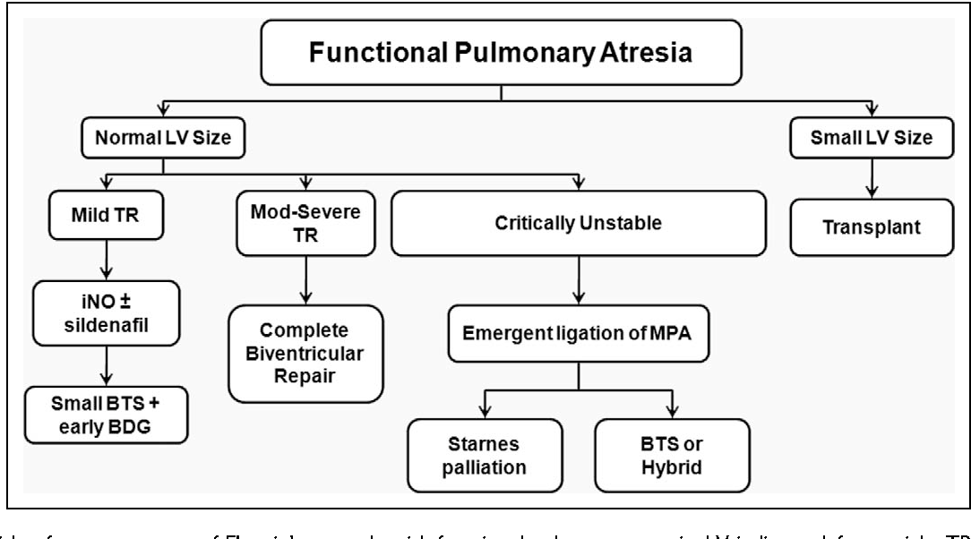

Slide 88
SURGICAL TECHNIQUES
A. Biventricular repair (Knott Craig approach)
B. Single ventricle pathway with right ventricular exclusion (starnes approach)
C. Cardiac transplant

Slide 89
Biventricular repair (Knott Craig approach)
TV is repaired and the atrial septum is partially closed
Repair typically a mono cusp type based on a satisfactory anterior leaflet
Right atrial reduction done to reduce the size of the markedly enlarged heart to allow room for the lungs
Although early mortality is high(25%) the intermediate outcome appears to be promising
Survival to hospital discharge was 74%

Slide 90
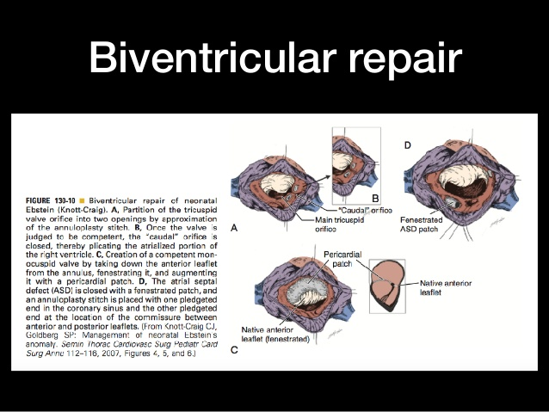

Slide 91
Single ventricle pathway with right ventricular exclusion (starnes approach)
Performed in anatomic RVOT obstruction
Objectives : exclude right ventricle and establish a reliable source of pulmonary blood flow
closing the tricuspid annular orifice using a pericardial patch, removing the entire septum primum and placing either a central aorto-pulmonary shunt or Blalock-Taussig shunt from innominate artery to right or left pulmonary artery
These neonates will subsequently need bidirectional Glenn procedure and eventually Fontan operation

Slide 92
Modified Starnes repair(total ventricular exclusion)
Sano et al. approach: total RV exclusion in which free wall of RV resected and closed primarily or with a poly tetrafluoroethylene patch
This simulates a large right ventricular plication which may improve filling and provide adequate decompression to the lungs and LV
Notes:
When tricuspid valve anatomy is
appropriate for repair, a biventricular approach is preferred. In patients with anatomic pulmonary valve atresia or
poor tricuspid leaflet anatomy, the single-ventricle strategy is favored.

Slide 93
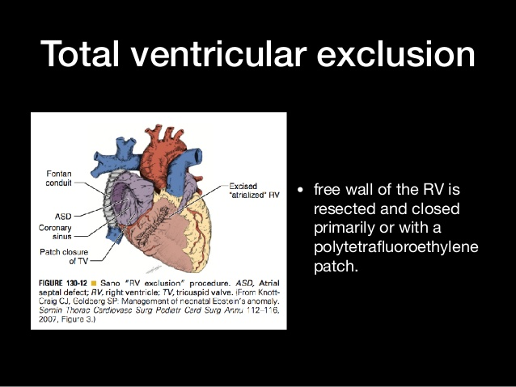

Slide 94
Cardiac transplantation
With the improved results of the biventricular and single ventricular approaches ,transplantation rarely is performed in the current era
Cardiac transplantation remains an option in the most severe forms of ebsteins anomaly particularly when there is significant left ventricular dysfunction

Slide 95
Childen and adults

Slide 96
Indication for surgery
Decreased exercise tolerance
Cyanosis (80% or less; Hemoglobin 16 gm% or more)
Paradoxical embolization
Progressive right ventricular dilatation (Cardiothoracic ratio >60%)
Prior to significant right ventricular dysfunction
Onset or progression of atrial arrhythmias
Prior to left ventricular dysfunction , NYHA class III or IV or significant symptoms

Slide 97
PRINCIPLES OF SURGERY FOR Ebsteins anomaly
Closure of any intra cardiac communications
TV repair or replacement
Ablation of arrhythmias
Selective plication of the atrialized RV from apex to base
Reduction right atrioplasty
Repair of associated defects(eg. VSD closure)

Slide 98
Repair of tricuspid valve
The goals of operation is:
To obtain a competent TV
Preserve right ventricular contractility
Decrease the risk of late rhythm disturbances

Slide 99
DANIELSONS REPAIR
Creation of a monocusp valve using the anterior leaflet
This consisted of –
Plication of the free wall of the atrialized RV
Posterior tricuspid annuloplasty
Right reduction atrioplasty

Slide 101
Modified Danielson Repair
Modifications involve-
Bringing the anterior papillary muscles towards the ventricular septum ,which facilitates coaptation of the leading edge of the anterior leaflet with the ventricular septum
Generally ,an antero posterior tricuspid purse string or ringed annuloplasty is used , and atrialized right ventricular plication is performed selectively
This results in a TV repair at the level of the functional annulus in contrast to the original repair which brought the hinge point of the functional annulus up to the true annulus

Slide 102
French Experience: Carpentier Repair
anterior leaflet and the adjacent part of the inferior leaflet were detached followed by longitudinal plication of the atrialized RV and RA
The anterior and inferior leaflets were repositioned to cover the orifice area at the normal level
Remodeling and reinforcement of the tricuspid annulus was performed with a prosthetic ring
Unlike the CR, the anterior and inferior leaflets were not mobilized or rotated clockwise to meet the septal leaflet

Slide 103
The VENTRICULIZATION PROCEDURE
Ullamann et al. described the ventriculization procedure in 2004
This is characterized by reintegration of the atrialized portion of the RV into the right ventricular cavity
Orthotopic transposition of the detached septal and posterior leaflets of the TV
Reimplanted septal leaflet serves as an opposing structure for coaptation of the reconstructed AV valve

Slide 104
THE BRAZIL EXPERIENCE (da silva approach)
Some septal leaflet should be present for this repair
Most anatomic- completion of the delamination process of the TV , providing 360 degrees of leaflet tissue around the AV junction with its hinge at the AV groove (true annulus)

Slide 105
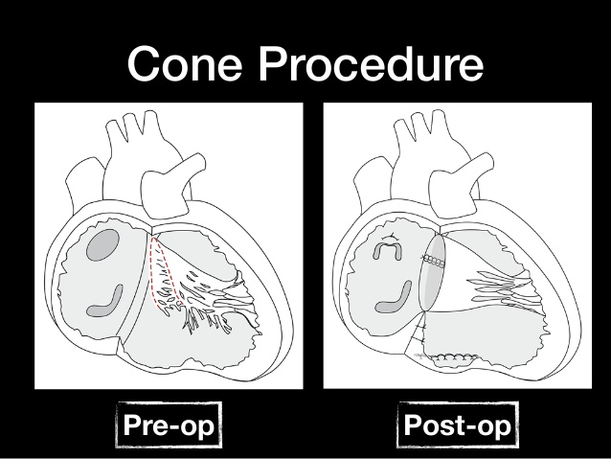
Notes:
Concept of the cone reconstruction in Ebstein malformation. A: Adherent segments of tricuspid
valve tissue being separated from the anatomic annulus and the underlying right ventricular myocardium. B:
Sheet of tricuspid of tissue after it has been released. This tissue is used to create a cone, often attaching the
anterior leaflet to the remnants of the septal leaflet (see suture line, C). Once the cone is created, the base is
attached to the atrioventricular junction, restoring the hinge points to a nondisplaced position (C). When dilated,
thin, or significantly dyskinetic, the atrialized right ventricle can be reduced in size by either elliptical resection or
plication (C). The annuloplasty reduces the size of the intraventricular junction to what is appropriate to the size
of the reconstructed cone

Slide 106
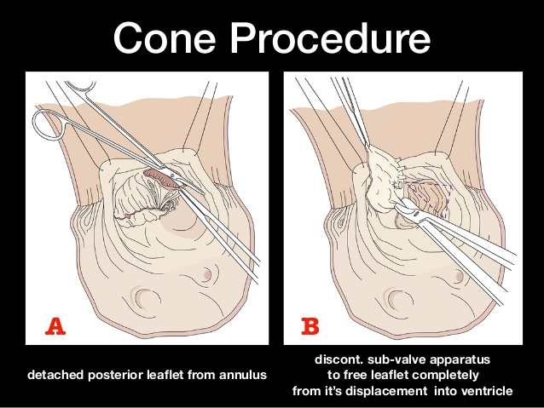

Slide 107
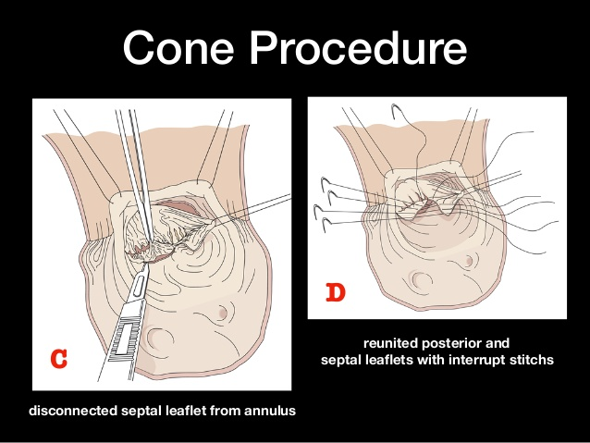

Slide 108
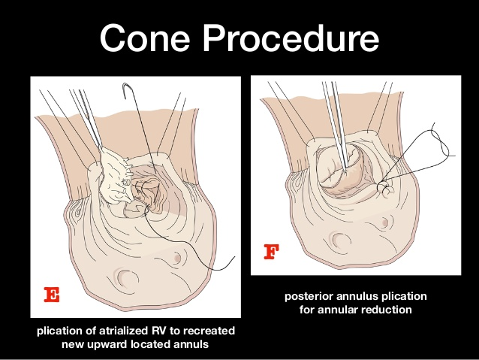

Slide 109
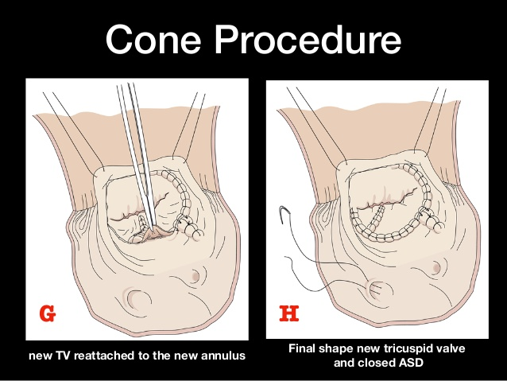

Slide 110
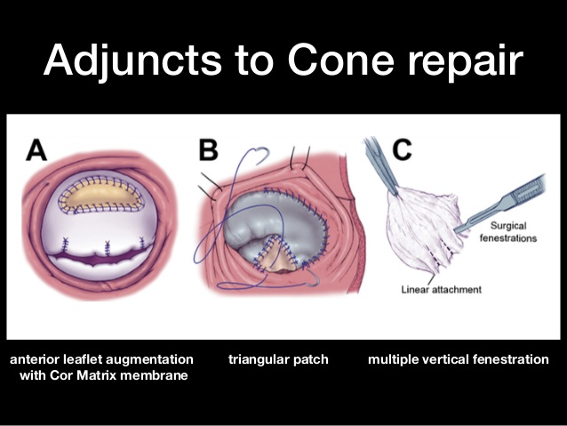

Slide 111
Relative contraindication to the reconstruction technique
(1) patient age >60 years
(2) moderate pulmonary hypertension
(3) severe LV dysfunction (EF <30%)
(4) absent septal leaflet
(5) heavy muscularization of the anterior leaflet
(6) severe tricuspid valve annular dilation with massive RV enlargement and systolic dysfunction (usually in older adults)
Notes:
Thus, tricuspid valve repair techniques continue to evolve, and there is no universally
correct technique because of the anatomic variation observed in patients with Ebstein anomaly.

Slide 112
TRICUSPID VALVE REPLACEMENT
Repair preferred than replacement
Porcine bioprosthetic valve replacement best option(bioprostheses preferred –lack of need of OAC)
During valve replacement , the suture line is deviated to the atrial side of the atrioventricular node and membranous septum to avoid the conduction tissue and right coronary artery injury -this results in an intra atrial position of the prosthesis

Slide 113
BDCPA
Two mechanism-
Reduces venous return to the enlarged , dysfunctional RV by approx. one third
Provides sufficient preload to the LV to sutain adequate systemic perfusion when right sided output is low
Preferred in the following situation
LVEDP is < 12 mmHg
Transpulmonary gradient < 10mm Hg
Mean pulmonary arterial pressure < 16mmHg

Slide 114
Indications for the BDCPA include
Severe RV enlargement or /and dysfunction
Squashed LV (D shaped LV)
Moderate degree of TV stenosis (mean gradient > 6mm Hg) as a result of reduction in the valve orifice area after repair
RA:LA pressure ratio > 1.5 indicates poor RV function
Preoperatve cyanosis at rest or with exercise
disadvantages:
(1) pulsatility of the head and neck veins, (2) facial swelling, (3) potential development of veno– veno collaterals and/or pulmonary arteriovenous fistulae, and (4) limitation of access to the heart from the internal jugular vein

Slide 115
One and a half ventricle repair
Indications
severely enlarged right atrium, severe tricuspid regurgitation, bidirectional shunt across the PFO/ASD, very hypoplastic right ventricle with minimal functional right ventricle, depressed LV systolic function or a combination
Surgery
patch closure of ASD, repair of tricuspid valve with reduction of the atrialized portion of right ventricle and a bidirectional Glenn operation (i.e. end to side anastomosis of the superior vena cava to the right pulmonary artery)
accomplishes the following—
unloads the right atrial and right ventricular volume by approximately one third and still, right ventricle can contribute to the pulmonary circulation maintaining pulsatile flow and allowing for flexibility to cope with transient increases in pulmonary vascular resistance and allows for more aggressive repair of the tricuspid valve without concern for tricuspid stenosis due to overcorrection.

Slide 116
Atrial septal fenestration
In RV dysfunction , an alternative to the bidirectional canopulmonary shunt
Involve either subtotal closure of an ASD or leaving a patent foramen ovale open

Slide 117
Transient episodes of exacerbated RV dysfuntion result in right to left shunting that increases left sided preload that minimizes or avoids low cardiac output to systemic circulation
Helpful in the neonates undergoing biventricular repair when increased pulmonary vascular resistance may still be present or exacerbated by the pulmonary vasoconstive effects of intropic support

Slide 118
Arrhythmia management
Atrial fibrillation and flutter –MC
Most surgeons used successfully the right sided cut and sew lesions of cox –maze III procedure in ebsteins anomaly
Radiofrequency ablation and cryoablation –procedure time for maze procedure is shortened significantly
A biatrial maze procedure , performed particularly when there is chronic atrial fibrillation , left atrial dilation or concomiatriant mitral regurgitation

Slide 119
Pacing
Permanent pacing is required for 3.7% of patients with ebsteins anomaly , most commonly for atrioventricular block and rarely for sinus node dysfunction
In the presence of a tricuspid valve prosthesis the ventricular lead for permanent DDD pacing usually is placed epicardially or through the coronary sinus or cardiac vein

Slide 120
Cardiac Transplantation
rarely required for Ebstein anomaly
In the Mayo Clinic experience the indication for
transplantation - presence of severe biventricular dysfunction with an LV EF <25%
Other indications: severe LV dilation and dysfunction particularly when associated with mitral regurgitation

Slide 121
Outcomes
severity of the valve malformation and dysfunction of both ventricles will affect outcome
Early mortality in neonates has been linked to marked RV enlargement, severe tethering of all leaflets, LV dysfunction, and pulmonary atresia
severe cardiomegaly (CT ratio >0.6) may also have lung hypoplasia

Slide 122
The mean age at operation was 24 years
Survival at 10 and 20 years was 90% and 76%, respectively
Survival free of late reoperation was 74% and 46% at 10 and 20 years
83% patients were in NYHA class I or II, and 34% were receiving no cardiac medication
improvement in exercise tolerance after operation
Longterm problems - reoperation and atrial tachyarrhythmias
Freedom from rehospitalization for cardiac causes was 68% and 35% at 10 and 20 years, respectively

Slide 123
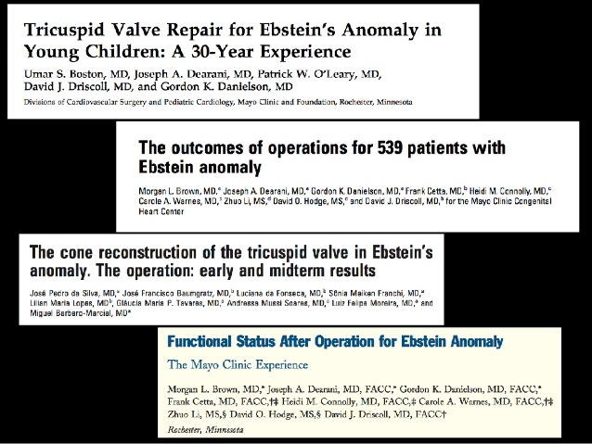

Slide 124
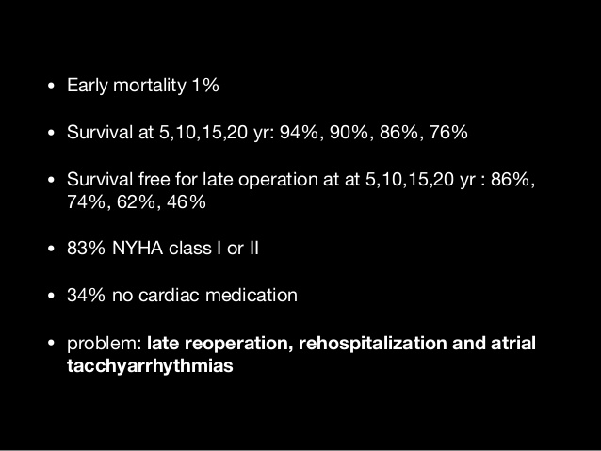

Slide 125
GUIDELINES

Slide 130
MCQ 1
Which of the following is true regarding Ebsteins anomaly
1. downward displacement of insertion of anterior leaflets
2. It is due to delamination of the inner layers of the inlet zone of the ventricles
3. displacement index - < 8mm/m2
4. related to accessory conduction pathways simulating Wolf-Parkinson-White (WPW) syndrome in 25%

Slide 131
MCQ 2
Ebsteins anomaly is associated with LVNC –gene associated is
GATA4
NKX2.5
MYH7
none

Slide 132
MCQ 3
Major ECG abnormalities seen in Ebsteins are
PR interval prolongation
Type A Wolff-Parkinson-White preexcitation
Atrial fibrillation or flutter
Deep Q waves in leads V5,6

Slide 133
MCQ 4
Surgical procedure for infants include all except
A. Biventricular repair (Knott Craig approach)
B. starnes approach
C.total ventricular exclusion
D. Danielsons procedure

Slide 134
MCQ 5
Indication for surgery in adults with ebstein are all EXCEPT
Decreased exercise tolerance
Cyanosis (80% or less; Hemoglobin 16 gm% or more)
Paradoxical embolization
Progressive right ventricular dilatation (Cardiothoracic ratio >60%)
significant right ventricular dysfunction
None

